Slide 1
Goldney Tour Guide

Slide 2
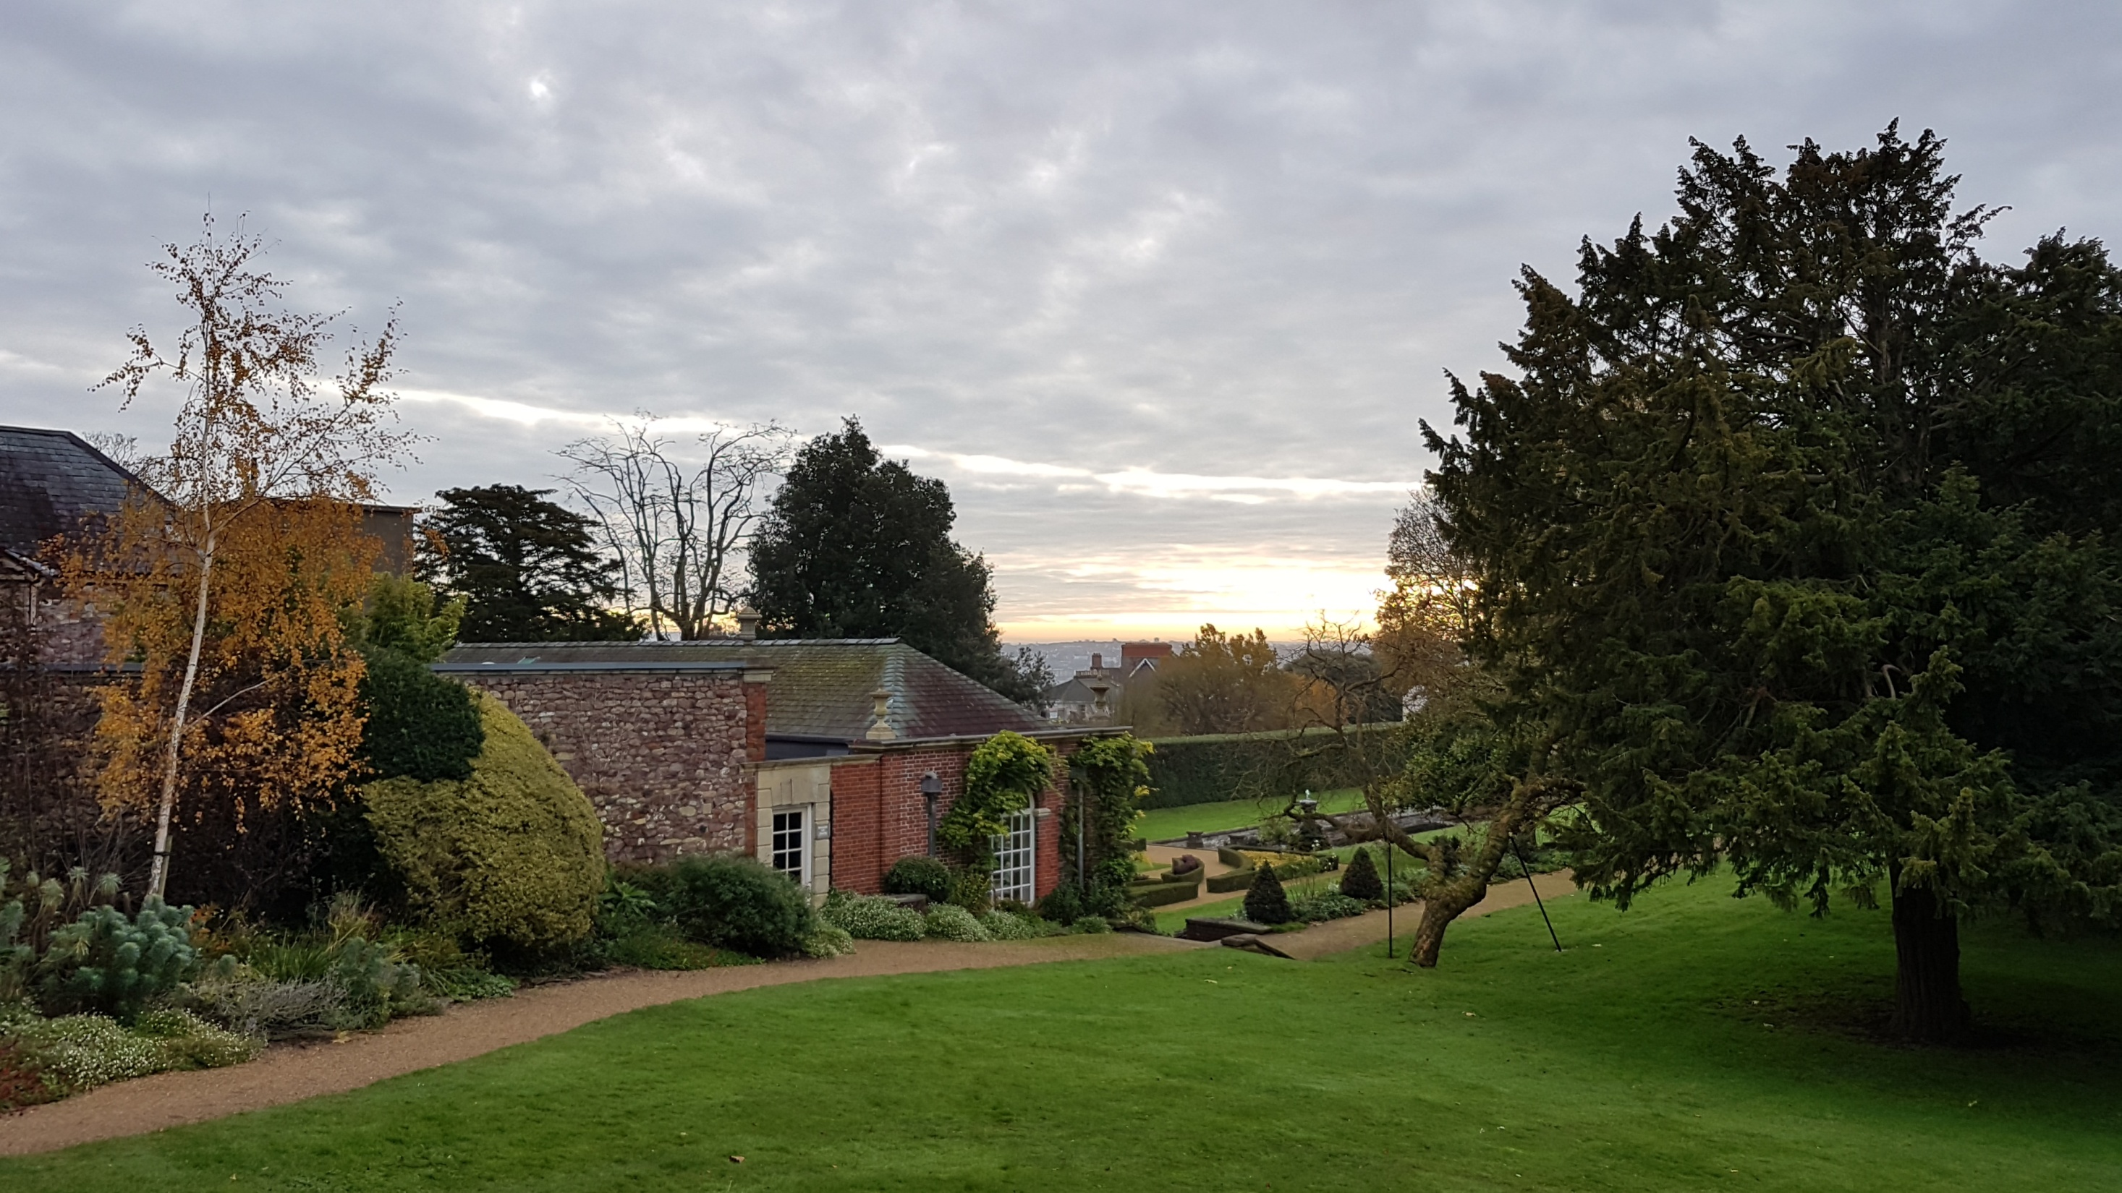
What is Goldney?

Slide 3
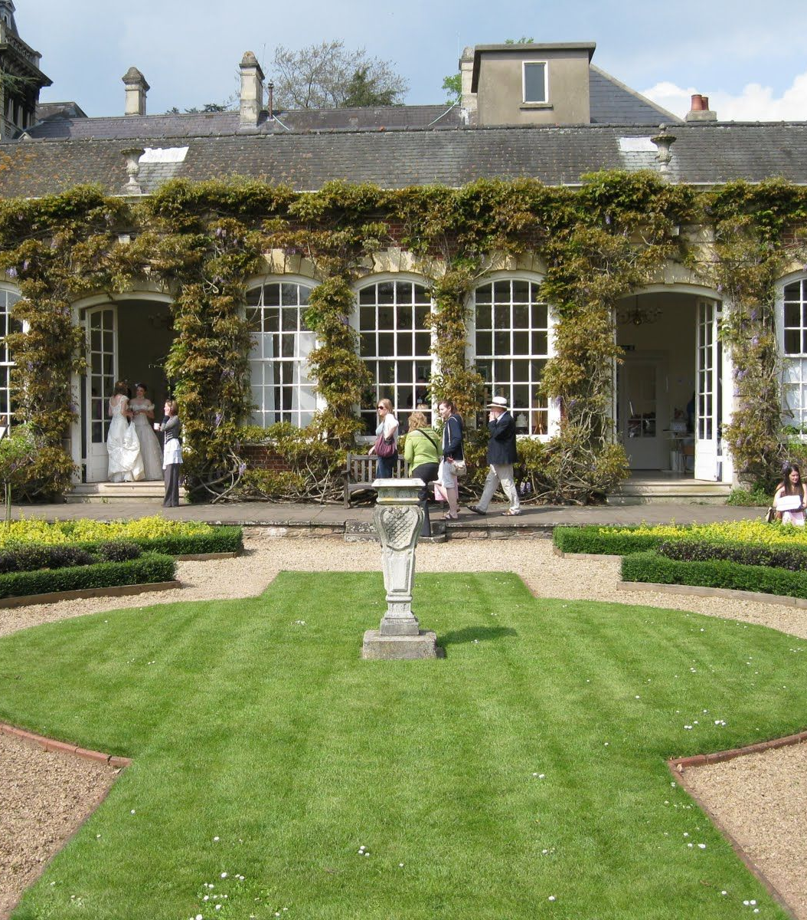
Project Brief

Slide 4
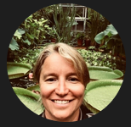
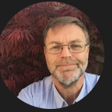
Stakeholders and Clients
University of Bristol Estates Team.
Set up by Andew Calway
Kasha and Alan
Specified Requirements over multiple meetings.

Slide 5
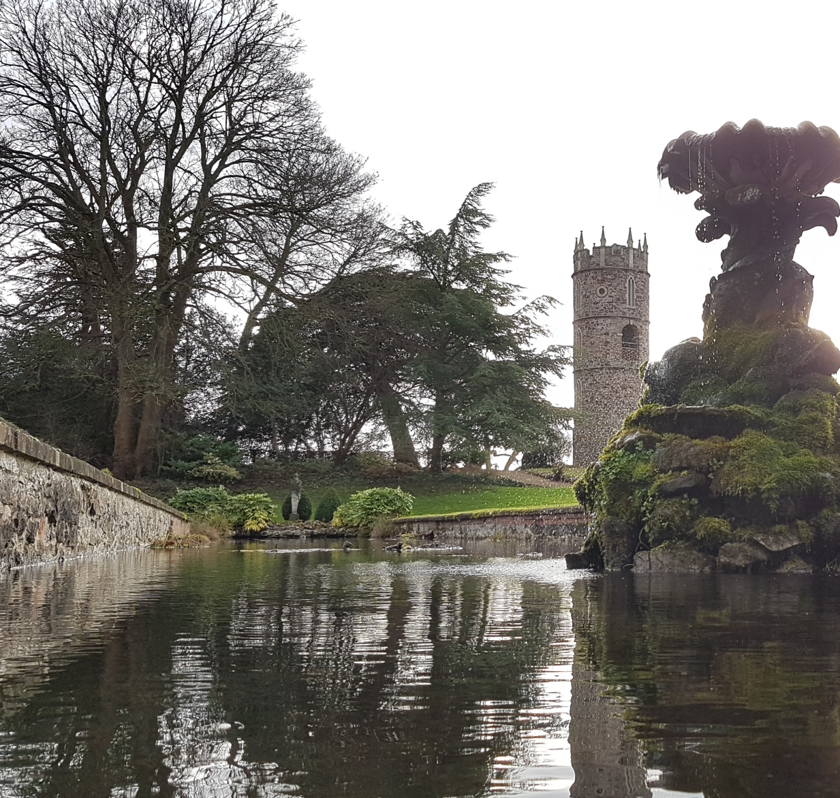
Our Solution
Mobile app
In-built QR / Barcode scanner
Local Data
Remote Database
Media Delivery
Themed UI

Slide 6
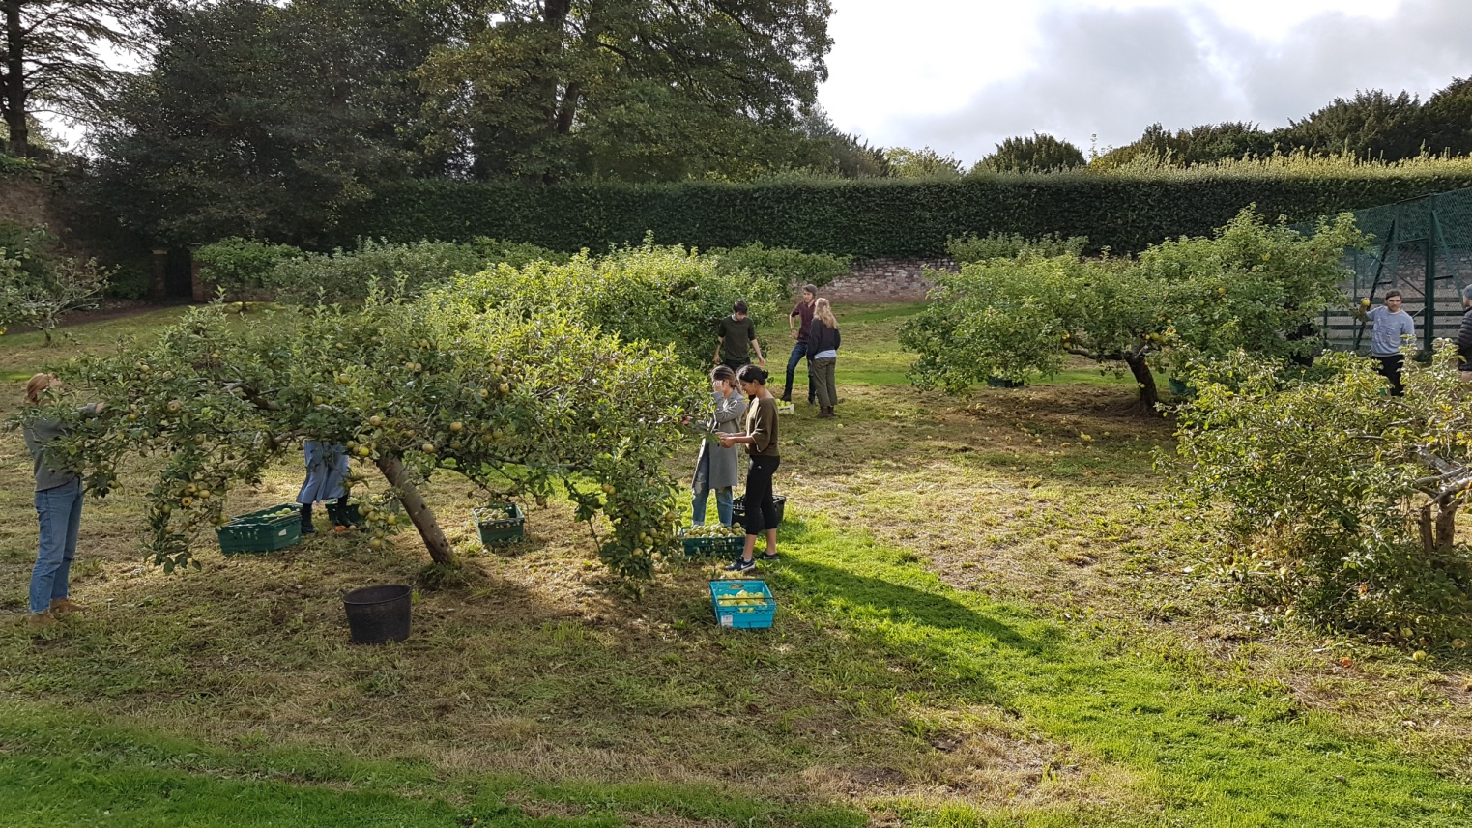
Our Solution
But most importantly…
Scalability

Slide 7
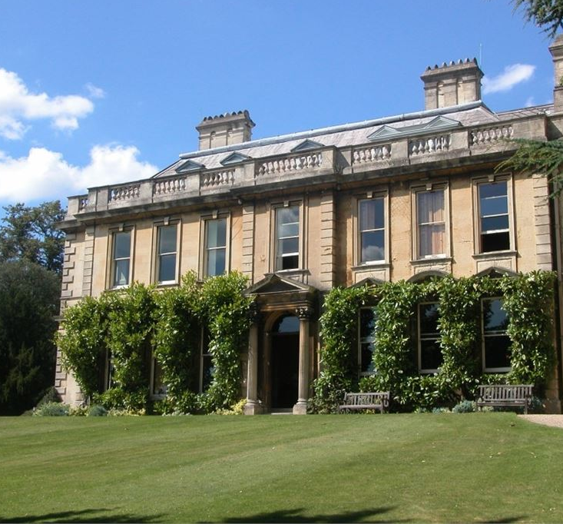


Releases
MVP

Slide 8



Releases
Beta
Release

Slide 9
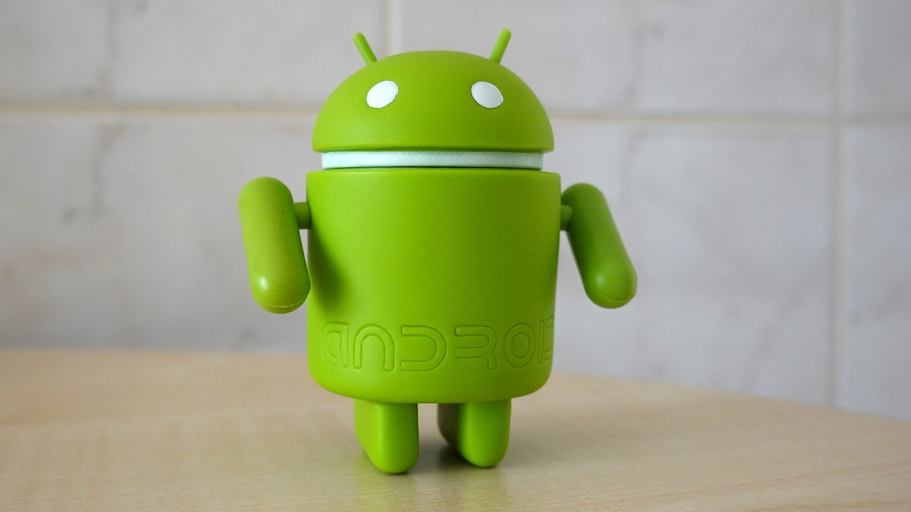
Why Android?

Slide 10
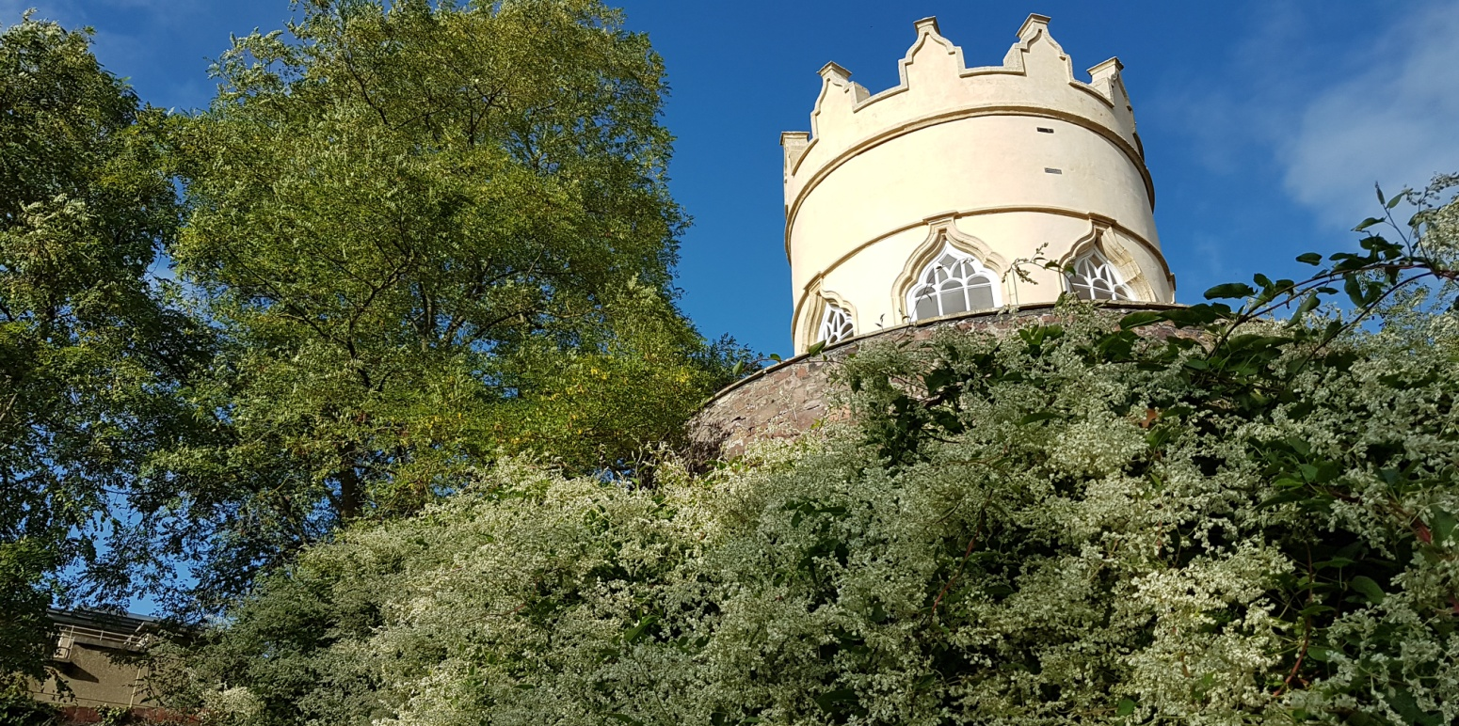
Our Architecture
AWS Media Storage
Content Upload Form
GO Server DB
Android App
Local Datastore
Default Encoded APK Content

Slide 11
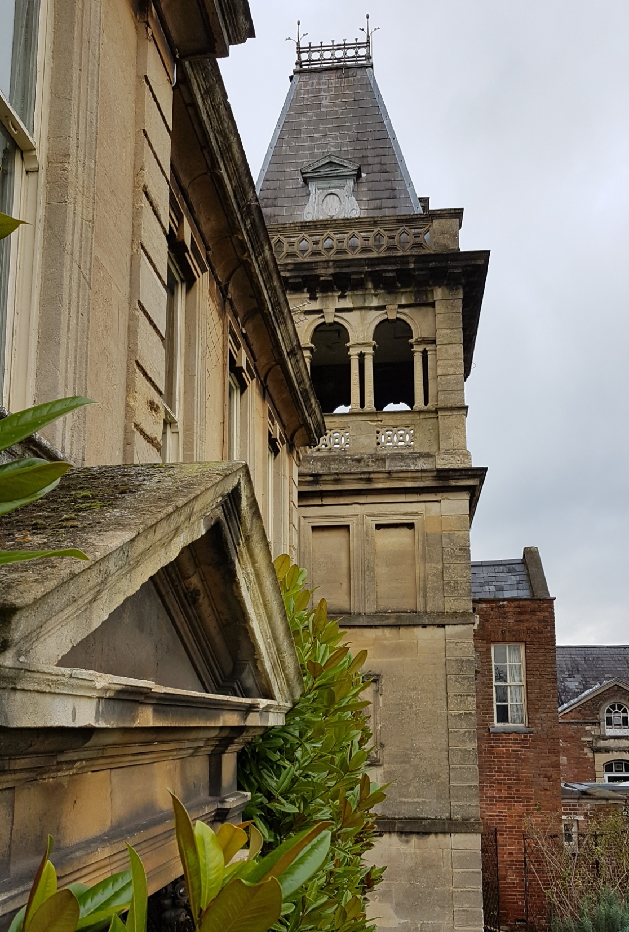
The Local End
Utilises both Java and Kotlin.
Integrated offline barcode scanner.
Poor internet connection in the garden means app should function offline.
App always searches local assets

Slide 12
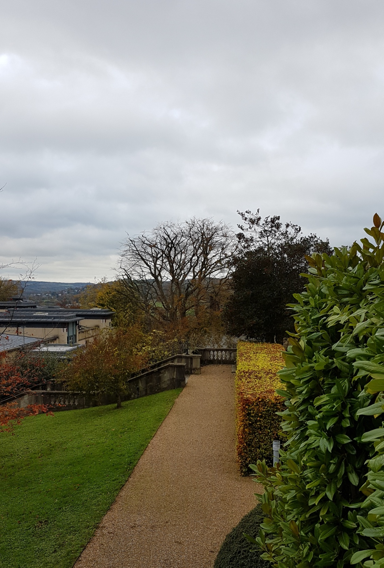
The Local End
Frontend app searches for updates on GO server.
If no data is found, unpack and load the APK’s asset folder.
Otherwise download changes to an internal app storage directory.

Slide 13
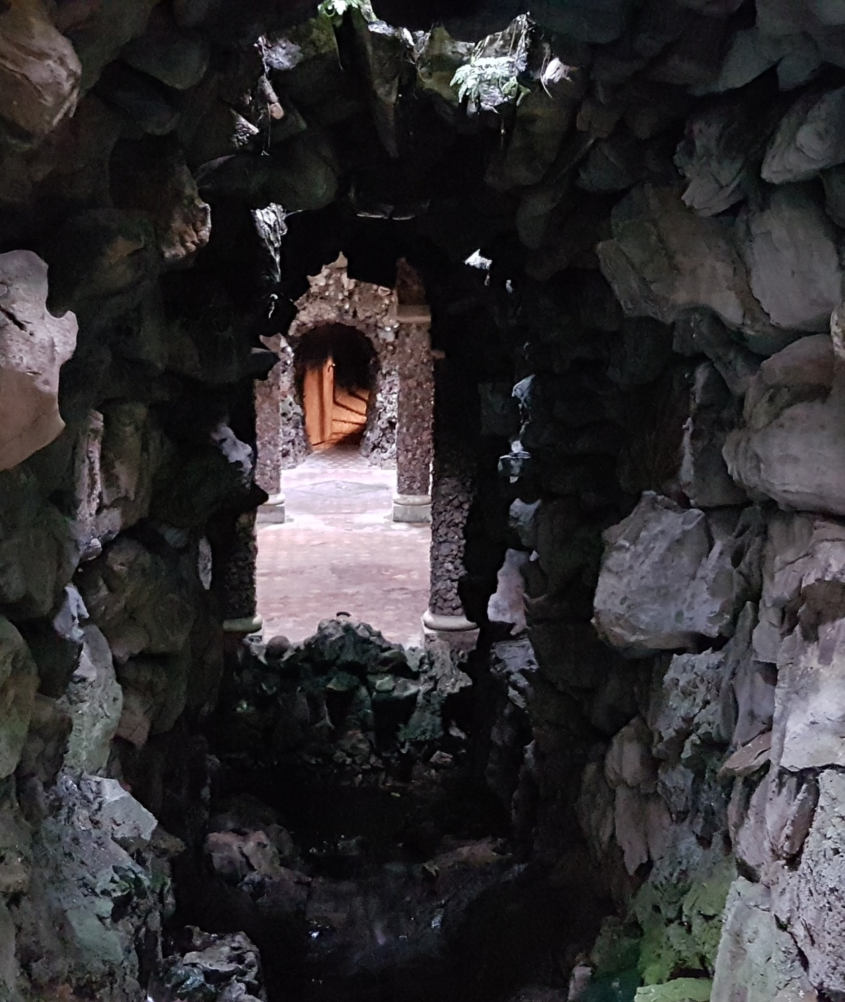
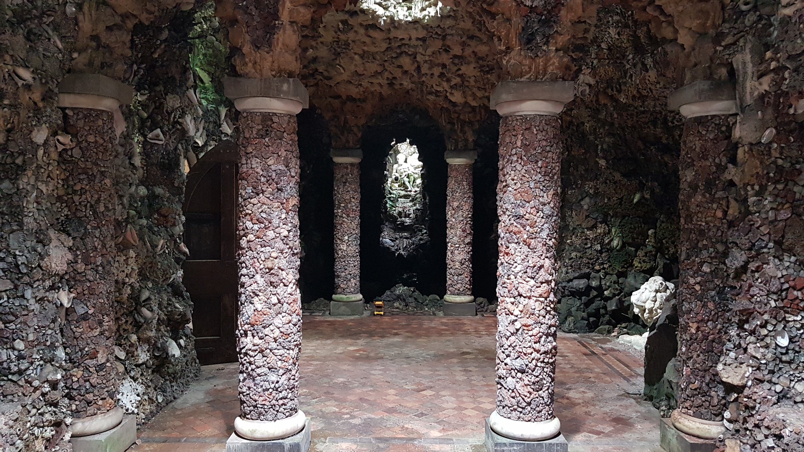
360 Degree Media Delivery

Slide 14
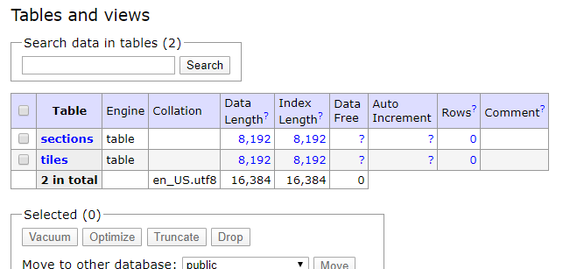
GO Database and Asset Content Delivery

Slide 15

Continuous Integration
Utilises GitHub webhooks.
Automated testing and deployment suite.
Bitbucket repository uses multiple branches (Staging, Dev, Master) for stable builds.

Slide 16
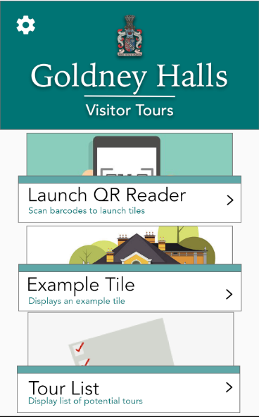
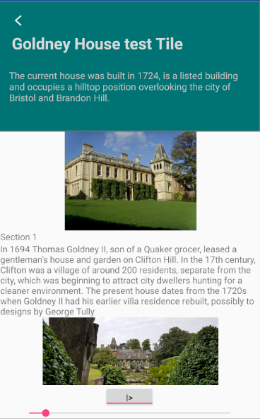
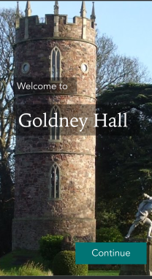
UI Design

Slide 17
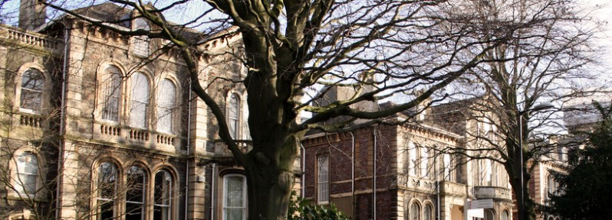
Interdisciplinary Project Nature

Slide 18
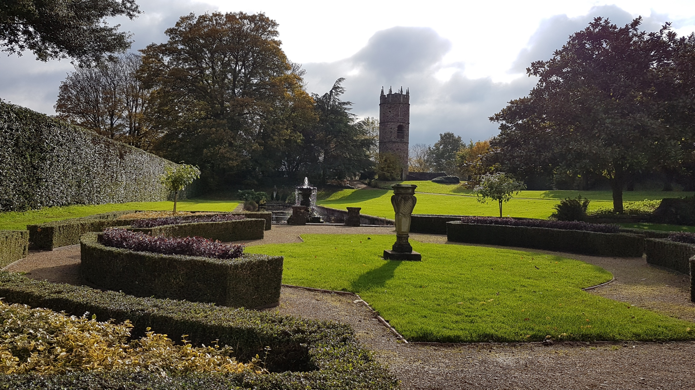
Planned Live Testing

Slide 19


